Slide 1
Econometric Analysis
Pulak Mishra
Department of Humanities and Social Sciences
Indian Institute of Technology Kharagpur

Slide 2
Basics of Econometric Analysis
Econometric analysis consists mainly of:
• Estimating economic relationships from sample data in respect of
Existence of the relationships
Direction of the relationships
Magnitude of the relationships
Prediction

Slide 3
Basics of Econometric Analysis
Four Major Elements of Econometric Analysis
Data - Collecting and coding of sample data
Model Specification –
Two components of an Econometric Model :
Economic Model
Specifies the dependent and independent variables and the functional form of the relationships
Based on economic theory/informal intuition/observation
Statistical Model
Specifies the statistical elements (particularly, statistical properties of the random disturbance term)

Slide 4
Basics of Econometric Analysis
Estimation - Computing estimates of the unknown parameters using the sample data
Inference - Using the estimates to test hypotheses about the unknown population parameters
Two types of statistical errors:
Statistical Errors
State of Nature | Do Not Reject H₀ | Reject H₀
H₀ | Correct Decision | Type I Error
H_{a} | Type II Error | Correct Decision

Slide 5
Basics of Econometric Analysis
Types of Data:
Cross-sectional Data – Generated at one point of time across cross-sectional units
Time-series Data - Consist of repeated observations on a cross sectional unit over an interval of time
Panel Data - Have both cross-sectional and time-series dimensions
Types of Models:
Bivariate Regression Model
Multiple Regression Model
Dynamic Model
Non-linear Model
Simultaneous Equation Model
Other Models (e.g. Logit, Probit, Tobit)

Slide 6
Basics of Econometric Analysis
Model Specification
Variables in the Equation(s) and their Functional Forms
A priori restrictions on the parameters
Stochastic Assumptions
Why Stochastic Component?
Omission of variables from the function
Random behaviour of human beings
Imperfect mathematical specification of the model
Errors of aggregation
Errors of measurement

Slide 7
Basics of Econometric Analysis
Stochastic Assumptions
Normal Distribution
Zero Mean
Constant variance
Independence across observations
Independence from the explanatory variable(s)
Major Econometric Problems
Autocorrelation
Heteroscedasticity
Multicollinearity
Endogeneity
Specification Bias

Slide 8
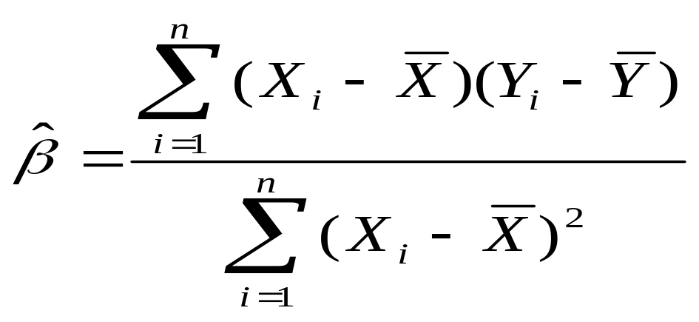
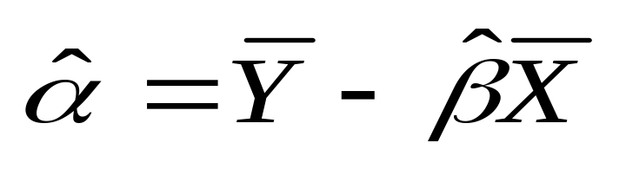
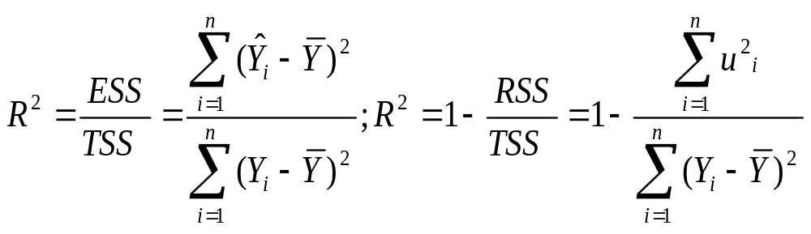
Bivariate Econometric Model
Important Formulae

Slide 9
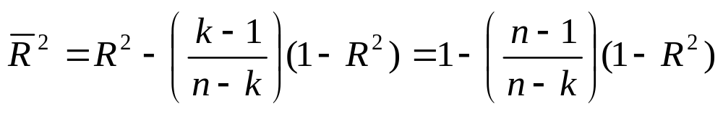
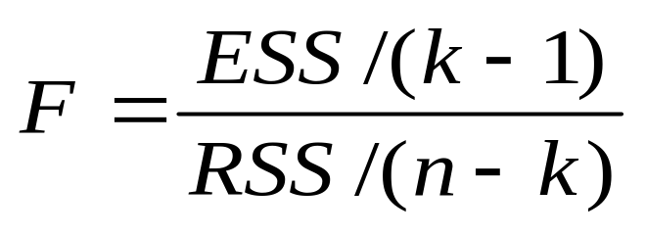
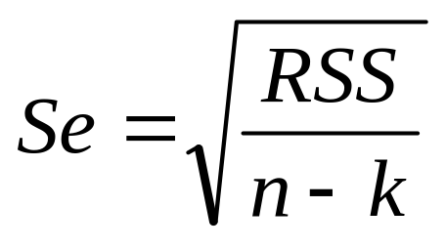
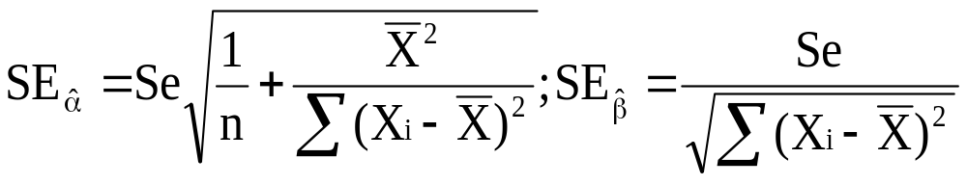
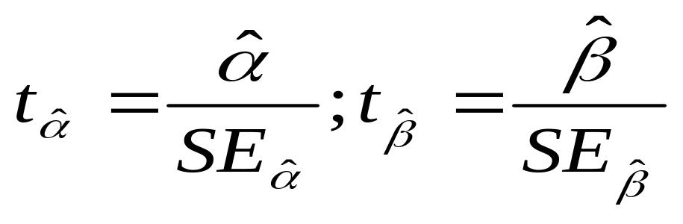
Bivariate Econometric Model

Slide 10
Bivariate Econometric Model: Example
Dependent Variable: Profitability (PAT/Sales)
Variable | Coefficient | t-Stat | Prob.>t
Intercept | 0.0246 | 0.57 | 0.573
Advertising Intensity | 8.2109 | 9.58 | <0.01
F( 1, 40) | 91.69
Prob. > F | <0.01
R-squared | 0.70
Adjusted R-squared | 0.69
Number of Observations | 42

Slide 11
Bivariate Econometric Model: Example
Dependent Variable: Profitability (PBT/Sales)
Variable | Coefficient | t-Stat | Prob.>t
Intercept | 0.2836 | 1.10 | 0.278
Advertising Intensity | 15.3796 | 3.01 | <0.01
F( 1, 40) | 9.08
Prob. > F | <0.01
R-squared | 0.19
Adjusted R-squared | 0.16
Number of Observations | 42

Slide 12
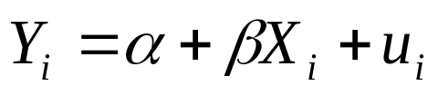
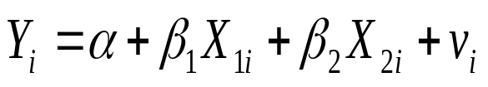
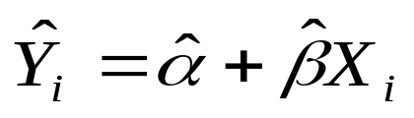
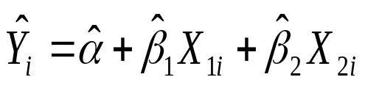
Multiple Regression Model
An extension of simple regression analysis
Two new problems:
Model specification
Isolation of effect of a particular independent variable from that of others
Fitted Model | True Model
 |  | Correct | Biased
 |  | Inefficiency | Correct

Slide 13
Multiple Regression Model
Forward Selection Method
Begins with no explanatory variable
At each step adds a variable whose partial F-Stat gives the smallest p-value
Entry continues as long as p-value of partial F-Stat is less than specified maximum value
Backward Selection Method
Begins with all possible explanatory variables
At each step eliminates the variable for which p-value of partial F-Stat is greater than a specified value
The process continues until no variable can be removed

Slide 14
Multiple Regression Model
Limitations
Some of the variables are never entered into the model and their importance is never determined
If a variable is included, it remains in the model even if it loses its significance with inclusion of other variable(s)

Slide 15
Multiple Regression Model
Stepwise Regression
A modified forward selection method
Eliminates variables that are not statistically significant
Included variables are excluded and excluded variables are included depending on their statistical significance
Limitations
Searches for data based models with high R²
May result in model selection bias
May results in biased regression coefficients

Slide 16
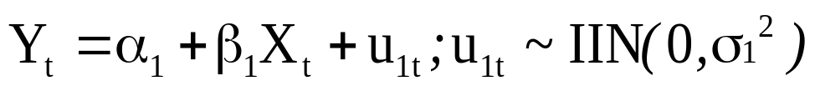
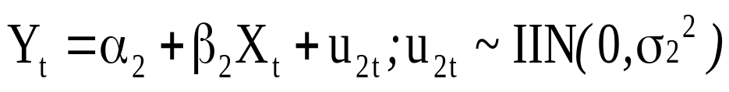
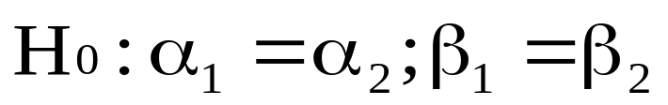
Testing for Stability
Tests for Stability - Testing constancy of parameters
Two Tests: (i) Analysis of Variance (ANOVA)
(ii) Predictive Tests
The ANOVA
Regression equations for two data sets
First Set:
Second Set:
Null Hypothesis:
Non-rejection of the null hypothesis indicates stability of parameters

Slide 17
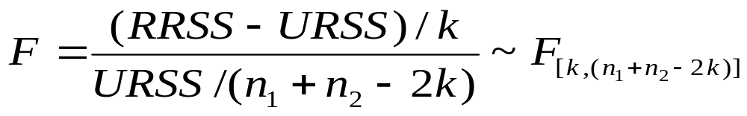
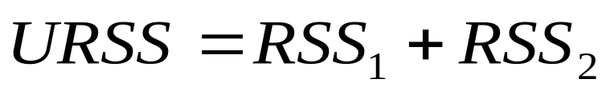
Testing for Stability
Test Statistic:
k = no. of parameters estimated (incl. intercept)
RRSS – Restricted residual sum of squares (for the pooled dataset)
URSS –Unrestricted residual sum of squares (separately for the individual datasets)

Slide 18
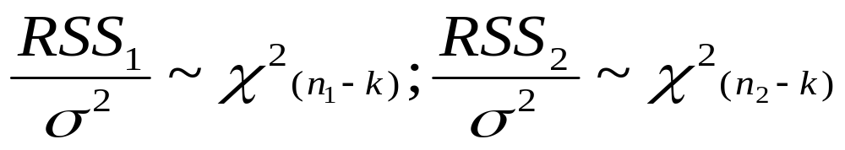
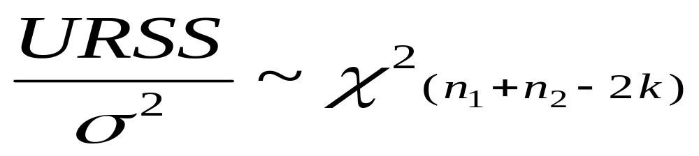
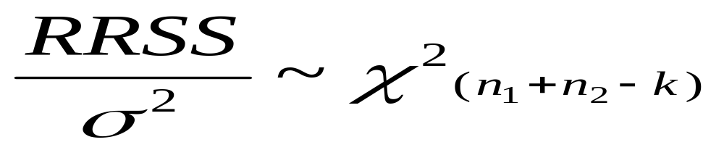
Testing for Stability
Here,

Slide 19
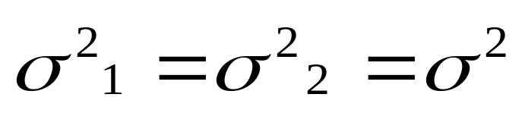
Testing for Stability
Limitations
Based on the assumption that
Only tells if the two regression equations are different
No clue about whether the difference is because of the intercepts, or the slopes, or both
Sensitive to the choice of the structural breaks
Can not be applied if n₁ or n₂ is less than k

